Slide 1
IST718 PROJECT PRESENTATION
TELTCOM CUSTOMER CHURN ANALYSIS
GROUP 13
Tian Jiang, Wanyue Xiao, Yiyuan Cheng

Slide 2
TABLE OF CONTENTS
01
03
05
Project Overview
Result Summary
Problem Encountered
Dataset Description
Project Objectives
Methods Summary
Models Performance
Error Analysis
Conceptual problem
Technical problem
02
04
06
Data Exploration
Inference Analysis
Member Contribution
Data Preprocessing
Data Visualization
Feature Importance
Business Insights
A brief description of what each team member contributed to the project

Slide 3
Project
Overview

Slide 4
Dataset Description
01
02
03
Personal Information
Customer Account Information
Available Services Plan
Gender, Senior Citizen, Partner, Dependents, Churn (Target)
Tenure, Contract Type, Payment Method, Paperless Billing, Monthly Charge, and Total Charges
Phone service, Multiple Lines, Online Security, Online Backup, Internet Service, Tech Support,
Device Protection, Streaming TV, and Streaming Movies
Learn More

Slide 5
Prediction and Inference
Prediction
Inference
Predict customer churn
K-Means Clustering,
Logistic Regression,
Linear Support Vector Machine,
Random Forest,
Gradient Boosting Model
Churn affected by:
the number of services registered
tenure period & monthly charges
gender and partnership
The most important features in predicting customer leaving and loyal customer
Is a linear model enough to capture the relationship?

Slide 6
Data
Exploration

Slide 7
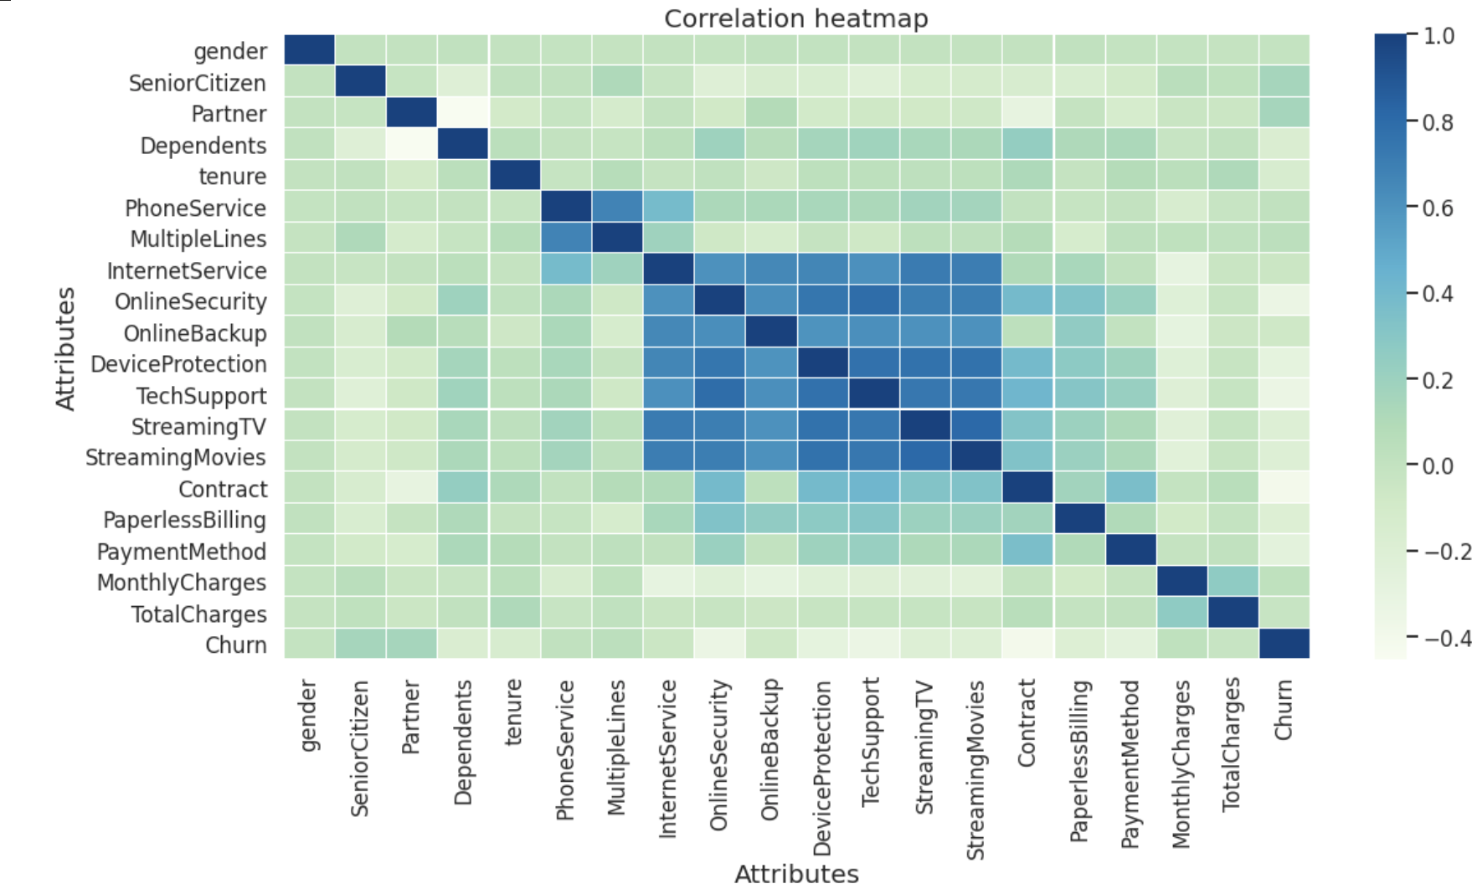
Data Exploration

Slide 8
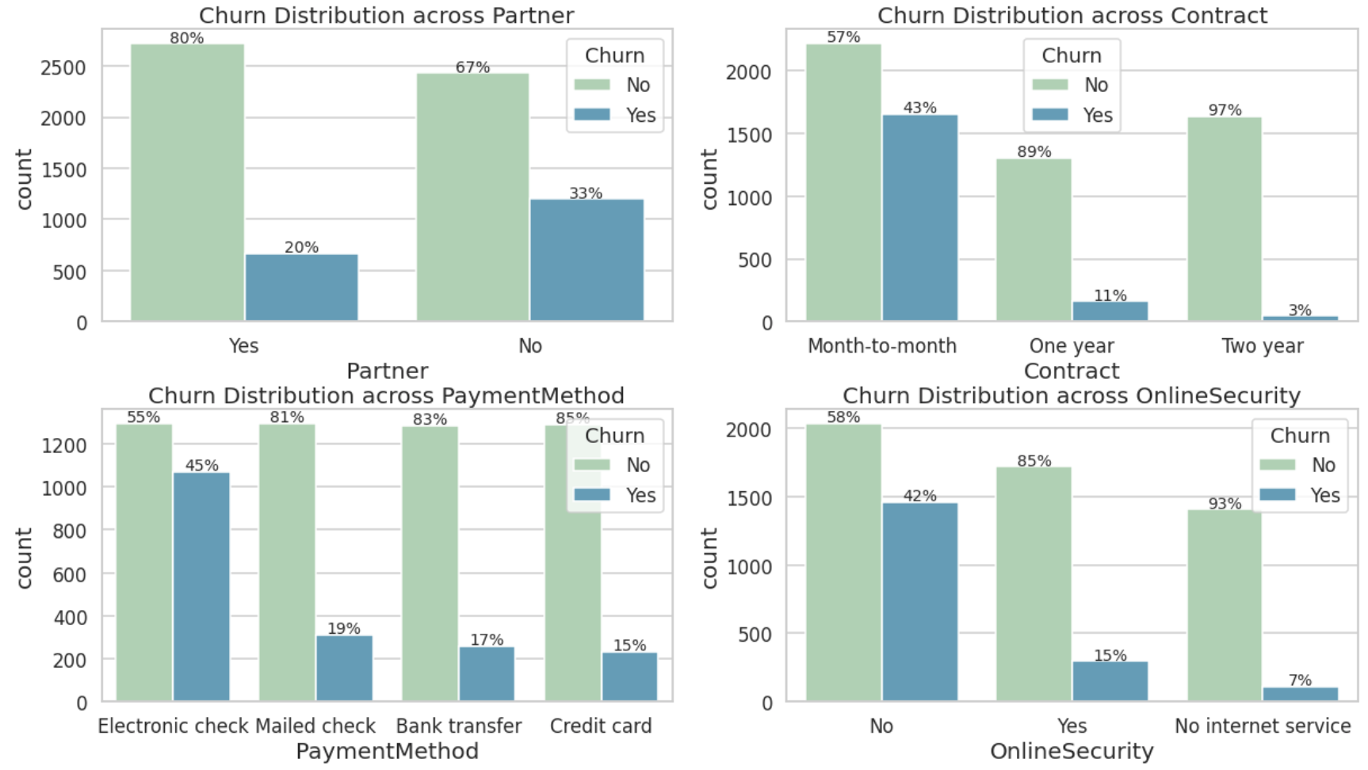
Data Exploration

Slide 9
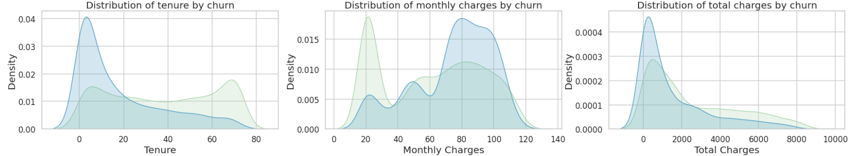
Data Exploration
Obvious Patterns:
Partner, Online Security Service, and Payment Method, has a relatively higher correlation with Churn.
Customer with fewer time spend on services prone to leave.
Lower monthly charge would help in reducing churn rate.

Slide 10
Result
Summary

Slide 11
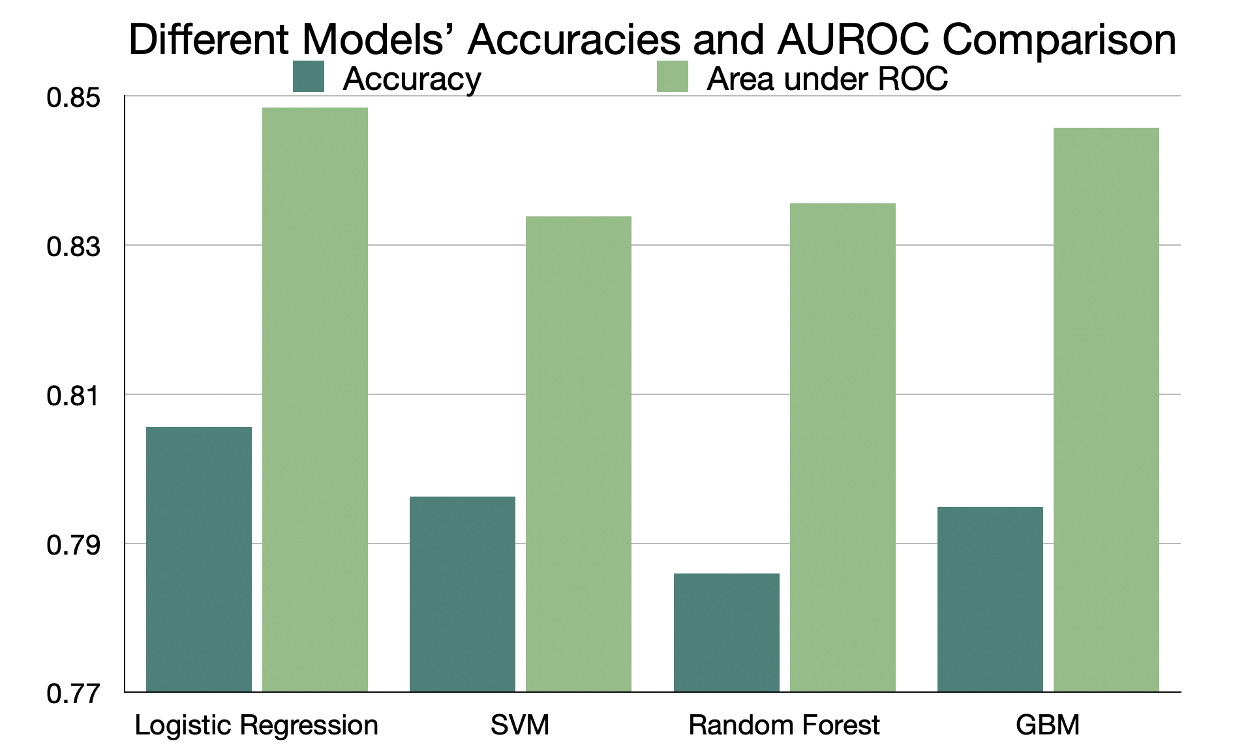
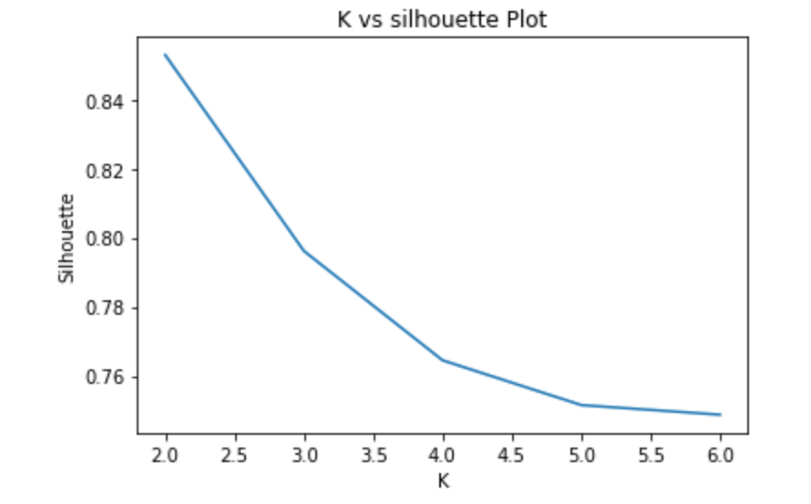
Model Performance
Optimal k in K-Means Clustering
3-Fold Cross Validation

Slide 12
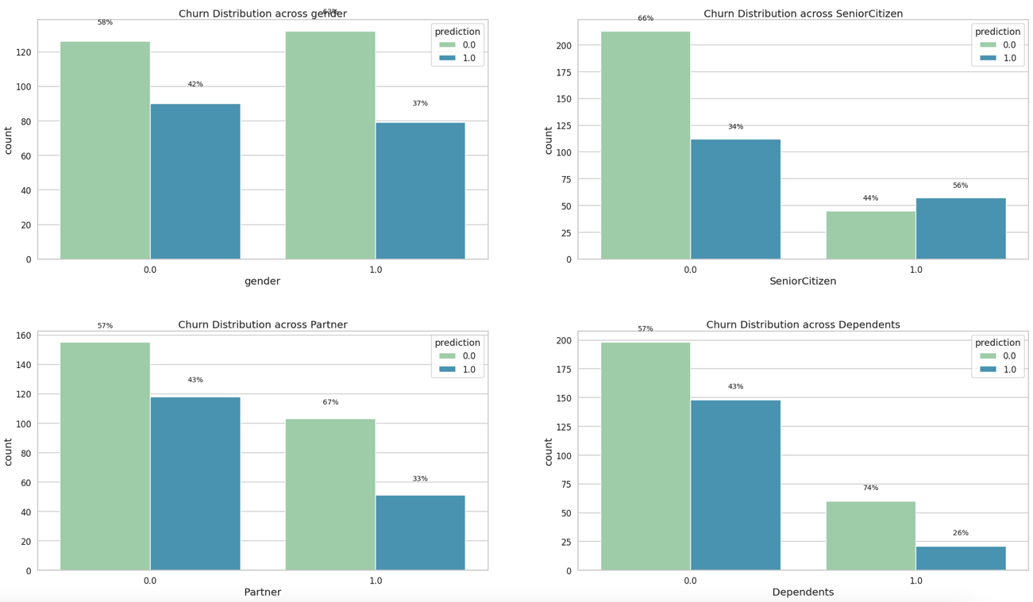
Error Analysis
1.0 = “Yes”
0.0 = “No”

Slide 13
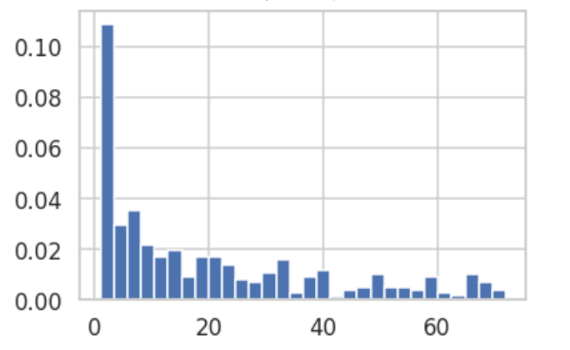
Error Analysis
Tenure Distribution in Error Prediction
Most wrong predictions are located between 0-20

Slide 14
Inference
Analysis

Slide 15
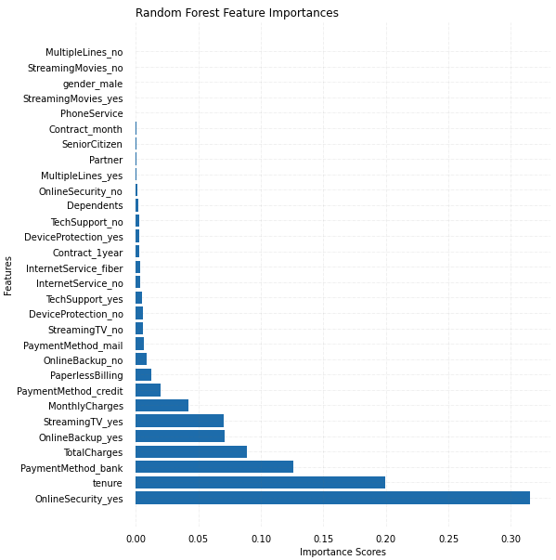
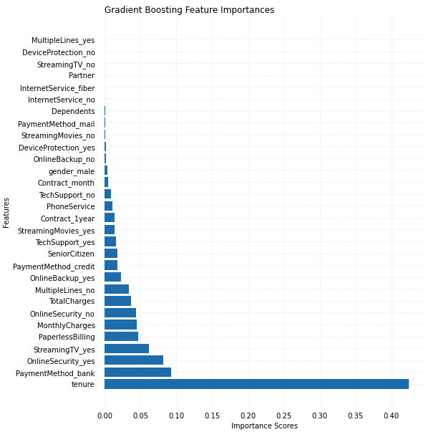
Feature Importance

Slide 16
Feature Importance
Number of service registered → churn
Account information → churn
Personal characteristics → churn
Influenced by specific services
Tenure, total charges, and monthly charges
Senior citizen, dependents

Slide 17
Feature Importance
Leaving Customer
Online Security
Bank Transfer
Streaming TV
Tenure, monthly charges, total charges, and payment method
Loyal Customer
Monthly Charges
Total Charges
Online Backup
Tech Support = yes
Online Backup = no
Is a linear model enough to capture the relationship?
Credit Card Payment (auto)
Tech Support
Paperless Billing

Slide 18
Business Insights
What services should the telecom company consider improving to diminish customer’s willingness to leave?
Which group of customers should be targeted to enhance their loyalty?

Slide 19
Problem Encountered
&
Member Contributions

Slide 20
Problems Encountered
Conceptual Problems & Technical Problem
Understanding the meanings of variables
Difficult to interpret the k-means output and PCA output
Technical: parameters tuning

Slide 21
Member Contributions
1
2
3
Jiang Tian
Wanyue Xiao
Yiyuan Cheng
Data Preprocessing
Exploratory Data Analysis
K-Means Clustering
Random Forest
Data Preprocessing
Logistic Regression
Linear Support Vector Machine
PowerPoint Making
Organization
Exploratory Data Analysis
Gradient Boosting Machine
Inference Summary

Slide 22
THANK YOU
GROUP 13
Tian Jiang, Wanyue Xiao, Yiyuan Cheng

